Slide 1
Variability in Software Systems
The Key to Software Reuse
Jilles van Gurp

Slide 2
Contents
Overview of the past 2 years
Papers in the thesis
Problems/Causes
Solutions
  Frameworks
  Software Product Lines
  Variability
Future/Current Work
Conclusion

Slide 3
History
Studied CS in Utrecht
Joined Jan Bosch in Ronneby late 1998
Got a masters degree from Utrecht early 1999
Continued doing research for Jan Bosch
Moved to Groningen summer 2000
Finished my Lic. in October 2000

Slide 4
Licentiate Thesis
Thesis consists of 4 papers + introduction
Download & view: http://www.xs4all.nl/~jgurp
Or pick one of the available copies.

Slide 5
Papers in thesis
Paper I: J. van Gurp, J. Bosch, “On the Implementation of Finite State Machines“, in Proceedings of the 3rd Annual IASTED International Conference Software Engineering and Applications, IASTED/Acta Press, Anaheim, CA, pp. 172-178, 1999.
Paper II: J. van Gurp, J. Bosch, “Design, implementation and evolution of object oriented frameworks: concepts & guidelines”, Software Practice & Experience, no 33(3) pp 277-300, March 2001.
Paper III: J. van Gurp, J. Bosch, “SAABNet: Managing Qualitative Knowledge in Software Architecture Assessment“, Proceedings of the 7th IEEE conference on the Engineering of Computer Based Systems, pp. 45-53, April 2000.
Paper IV: J van Gurp, J. Bosch, M. Svahnberg “On the notion of variability in software product lines“, submitted to Wicsa 2001, Januari 2001.

Slide 6
Looking back
I started with frameworks
Then came assessment of frameworks and architectures (paper III)
Currently I’m concerned with the key mechanisms behind frameworks and reusable architectures
The keyword is variability

Slide 7

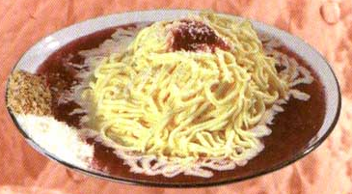
Building Software
Theory vs. practice
Nice building blocks that can be used to create new software
So many dependencies that nobody understands it anymore

Slide 8
Theory vs. practice (2)
Theory: Component = building block with well defined interfaces
Practice: Component = large (100 KLOC is nothing) blob of software with no clear boundaries

Slide 9
Problems
Everything is connected to everything
Changes may have system wide consequences
Each change increases the above problems
Radical changes are increasingly less cost effective
The development strategy is to work around problems rather than addressing them

Slide 10
Causes
Requirements are not stable, new ones are added constantly
Some of the requirement changes were not anticipated during the design
The software was not designed to incorporate such changes

Slide 11
Solutions
OO Frameworks?
Software Product Lines?
Variability management?

Slide 12
OO Frameworks?
RE Johnson: Framework = Components + design patterns
We: Framework: a set of classes, abstract classes, interfaces and OO components bundled in a set of modules that partially implement an application in a particular domain.
Notes:
* Waarschijnlijk komt deze definitie uit PLOP (evolving frameworks, roberts & johnson)

Slide 13
Why yet another definition?
We discuss a lot in the thesis:
  OO
  SPLs
  Components
  ….
Without proper definition the discussion becomes meaningless
Unfortunately there are no one-size-fits-all definitions, so we created our own

Slide 14
Why so specific?
Terms like OO and frameworks tend to be heavily overloaded
We want to make statements about frameworks, we need to decompose
The more specific our definitions are, the more specific our statements are

Slide 15
Contributions in OO Fws
Definitions based on existing literature and current practice.
Motivated the use of Role Oriented Programming (next slide)
Guidelines for designers (Paper II)

Slide 16
Roles & Objects
Without roles: Class = Type
With Roles: Class has more than one Type
Class Type = interface. So a class with roles has more than one interface.

Slide 17
Roles, why?
Objects collaborate in many ways
Usually only part of the interface is needed in a particular collaboration
The rest of the interface is not needed in such collaborations
Objects of other classes may collaborate in the same way

Slide 18
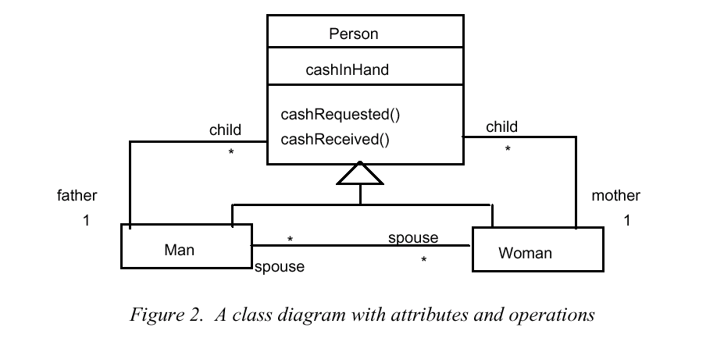
Example

Slide 19
Expressiveness
This model expresses that
  a person can own cash
  receive cash
  be requested for cash
However, it can’t express that
  a person gives cash to another person because there’s no way to identify the involved persons in the transaction from the set of all persons

Slide 20
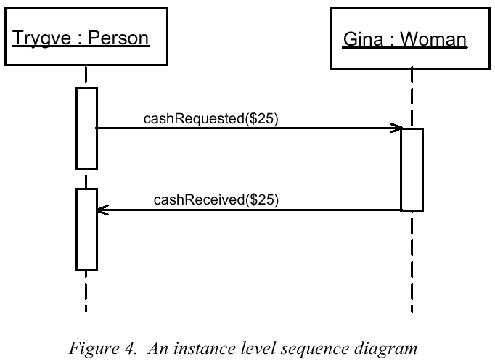
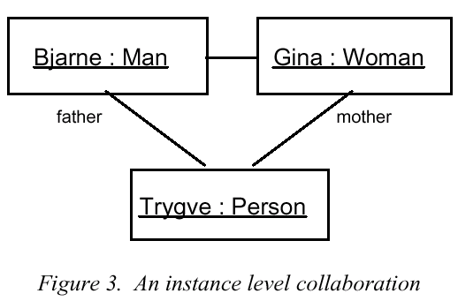
Object Collaboration

Slide 21
Expressiveness
This model is very concrete
  a particular object with the identity “Trygve” requests and receives cash from another particular object “Gina”.
This model is too concrete because it only applies to Trygve and Gina
It doesn’t scale up (imagine having to model the collaborations for 1000 persons like this)

Slide 22
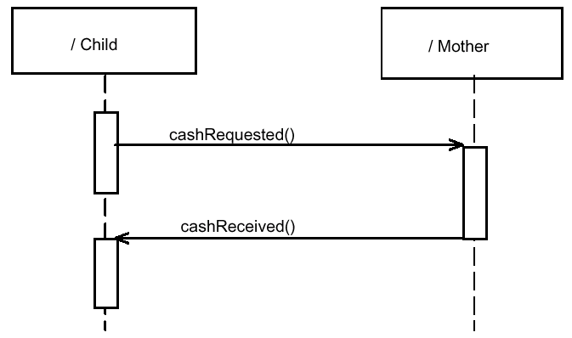
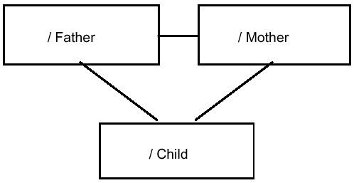
Specification level Collaboration

Slide 23
What’s different
Objects have been replaced with Roles
  ClassifierRole: A named slot for an object participating in a specification level collaboration. Object behavior is represented by its participation in the overall behavior of the Collaboration. Object identity is preserved through this constraint: “In an instance of a collaboration, each classifierrole maps onto at most one object”.
One object can play multiple roles
One role can be implemented by multiple classes

Slide 24
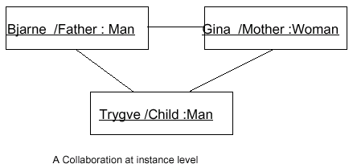
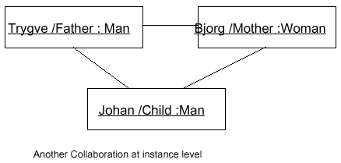
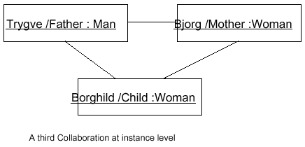
A bit more concrete

Slide 25
Implementation
Java allows classes to implement more than 1 interface.
Multiple Inheritance can be used to do the trick in other languages (Mixin)
IDL interfaces can be used in a COM or Corba like architecture

Slide 26
Software Product Lines?
>> Frameworks
Similar to product lines in e.g. a car factory
Involves:
  Architecture (e.g. frameworks)
  Reusable parts (e.g. components, libraries)
  Hotspots/plug points (e.g. IDL interfaces, abstract classes)
  Development Process Issues (e.g. waterfall model)
Large amounts of code are involved (millions LOC)

Slide 27
More about SPLs …
See the SPL book:
Design and Use of Software Architectures
Adopting and Evolving a Product-Line Approach
By Jan Bosch
ISBN 0-201-67494-7, Addison Wesley, June 2000

Slide 28
So, why build a SPL?
Practice shows:
  Opportunistic reuse does not work: you need to plan ahead otherwise you’ll keep reinventing the wheel.
  It saves you time when creating new products:
    time to market
    allows you to focus on the product specifics

Slide 29
Building a SPL
Is planning for change: you decide what things are not going to change from product to product
It’s separating the static parts (commonality) of your software from the variable parts (variability)

Slide 30
Variability?
A returning topic in both SPLs and FWs
The title of my thesis says it is the key to software reuse

Slide 31
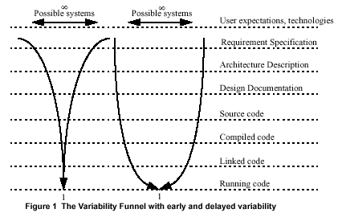
Variability during the development

Slide 32
Variability is …
Delaying design decisions
Leaving things open

Slide 33
Variation point
A concrete place in the system where variants of a particular entity can be inserted
Properties:
  Representation (e.g. architecture design, UML class diagram, source code, …)
    E.g a #define in the source code; an abstract class in the design
  Design status: implicit -> designed -> bound
    E.g. variation point X is designed during Detailed Design. Before that, it was implicit. At some point in the future it will become bound
  Binding time (I.e. binding a variant to the variation point)
    E.g. instantiating a subclass of an abstract class.
  Open/closed for new variants
    E.g. creating a subclass during Detailed Design implies that the variation point is open during Detailed Design.

Slide 34
Features & Variability
Features can be seen as a unit of change in software systems
Variability points can thus be described in terms of features
Feature diagrams can be used to identify where variability is needed

Slide 35
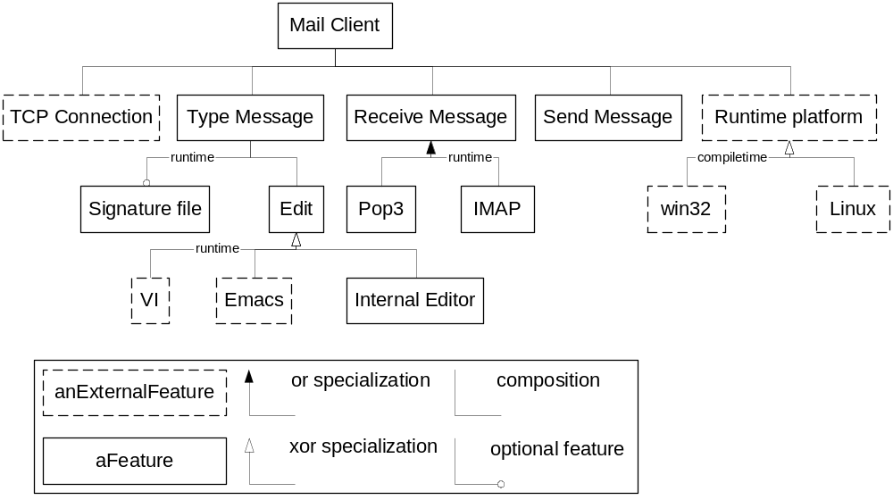
Example Feature Diagram

Slide 36
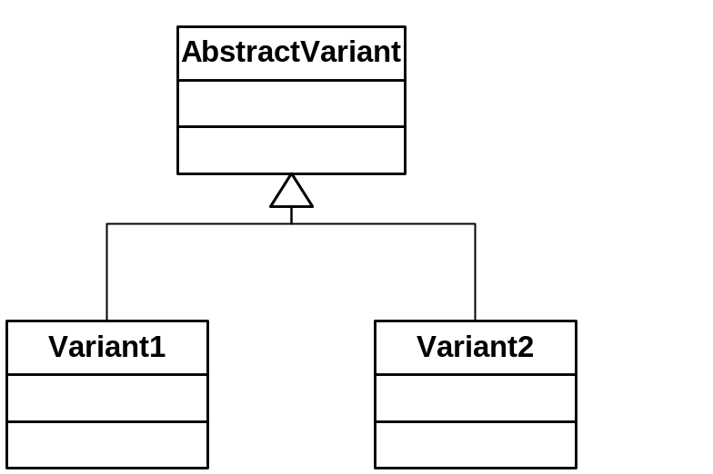
Variability = specialization
Each time you leave open a decision, you put in some generic description of the possible variants. A variant then is a specialization of this description.

Slide 37
Variability != limited to design phase
We can have variability in any development phase, including run-time!

Slide 38
Variability Realization Techniques
Technique | Binding-time | Examples | Abstraction
Inheritance | Implementation | GUI Components | Abstract class
Plugins | Link-time / Run-time (language dep.) | Winamp visualization | Interface
Parameters | Application startup | Xterm parameters | A variable
#define | Compilation | Support for different platforms | Preprocessor variable

Slide 39
Management of variation points
Identify variation points (e.g. by making feature diagrams)
Assess the variation point properties
Specify the abstract variant (e.g. create abstract class)
Collect the variants (e.g. create subclasses)
Bind the variation points to a variant (e.g. instantiate a class and assign the instance to a property)

Slide 40
A method
Make Feature Diagram
For each variation point:
Abstraction level
Assess binding time
When it’s open
Select Realization Technique + variant management technique (e.g. manual or automatic)
Add variants
Bind

Slide 41
Reuse requires Variability
Reusing = using an existing piece of software in a new situation
The reused part needs to be adapted to the new situation
  Set paramaters, Change the interface, Remove redundant pieces, Adjust some functionality
Reusable parts must facilitate variability
  The more situations a part can adjust to the more reusable it is
  A part that can only adjust to 1 situation is not reusable

Slide 42
How much variability do we need?
Just enough to meet future requirements
Too much: Flexibility usually costs you in terms of complexity, time to market, performance, maintainability …
Too few: You may not be able to meet a new requirement, you may have to work around design errors, starting from scratch is becoming good alternative to adapting the system.

Slide 43
Future/current work
What are the limitations of OO?
How can we work around these limitations?
How useful are OO extensions such as AOP and SOP?
  AOP = Aspect Oriented Programming
  SOP = Subject Oriented Programming
Can we lift novel approaches to the architecture level?

Slide 44
Constraints on our work
We can’t expect radical programming paradigm shifts so we have to rely on existing technology
Whatever we come up with: it has to be applicable to large industrial systems
We don’t want to focus on implementation solutions, instead we want to focus on architecture

Slide 45
Recent work
Two Wicsa Papers:
  Revised version of the variability paper
  A paper discussing a case study regarding Architecture Erosion
Architecture Design & Separation of concerns

Slide 46
Summary/conclusion
Title says all:
Variability in Software Systems
The Key to Software Reuse
Questions?

